Slide 1
NeuroFleetX – AI-Driven Urban Mobility Optimization
A Smart Transportation System for Efficient Ride Booking & Fleet Management

Slide 2
Problem Statement
Urban transportation faces several challenges:
  Unorganized fleet management leading to delays and inefficiency.
  Manual ride assignment causing slow allocation and increased wait times.
  No centralized dashboard for admins to manage users, vehicles, and complaints.
  Lack of transparency for customers regarding ride status and tracking.
These issues reduce customer satisfaction and increase operational workload.

Slide 3
Proposed Solution
NeuroFleetX provides an end-to-end intelligent mobility platform:
  Ride booking system with automated driver assignment.
  Customer dashboard to track rides, cancel bookings, and view ride statistics.
  Admin dashboard to manage users, vehicles, complaints, and analytics.
  Vehicle health monitoring for proactive maintenance.
  Efficient complaint handling with real-time status updates.
This provides a faster, more reliable, and scalable transport solution.

Slide 4
Major Functionalities
User Authentication Module
Vehicle Booking Module
Auto Driver Assignment Module
Vehicle Management Module
Driver Management Module
Feedback, Complaints & Analytics Module

Slide 5
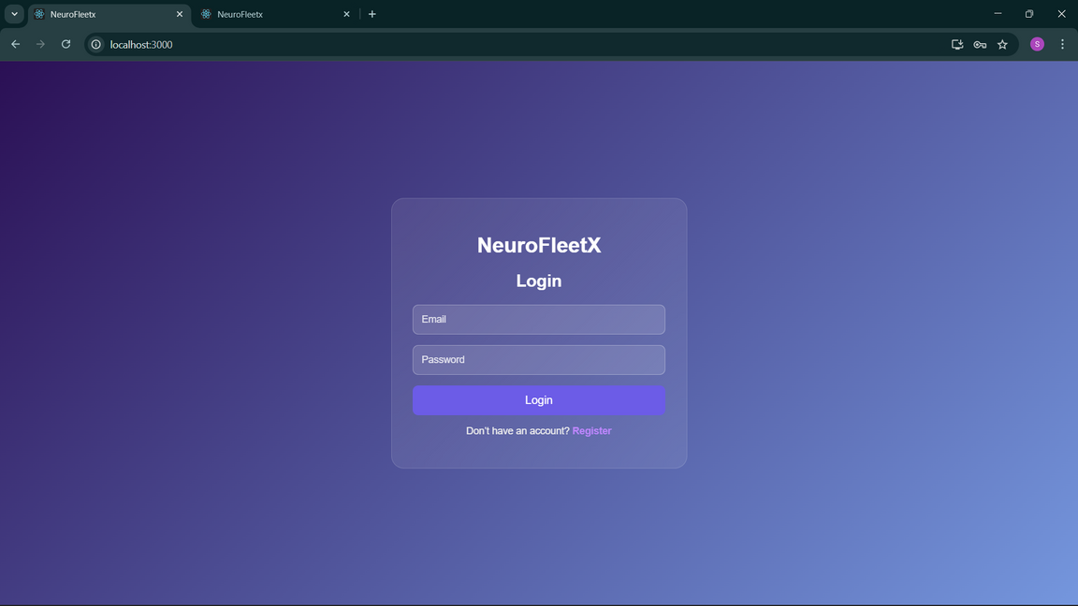
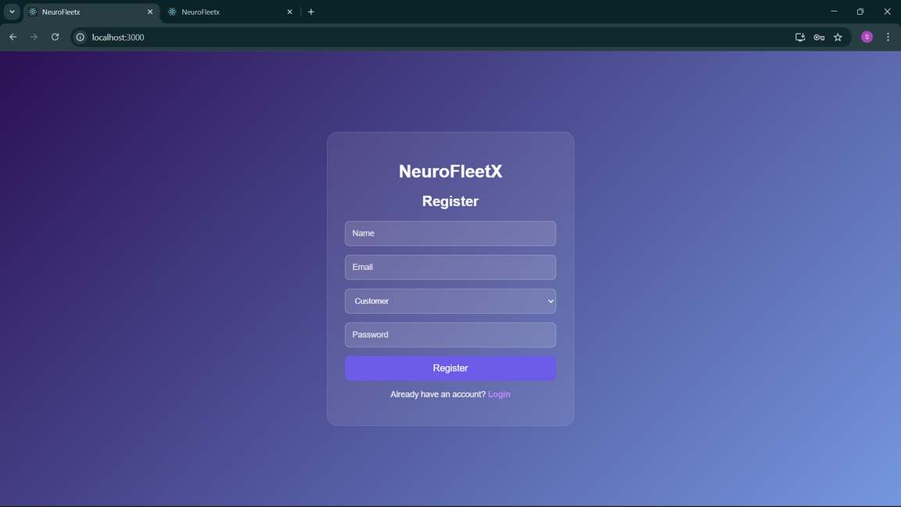
Module 1
The application includes a simple Register page for new users to create an account and a secure Login page that allows both users and admins to access the platform.

Slide 6
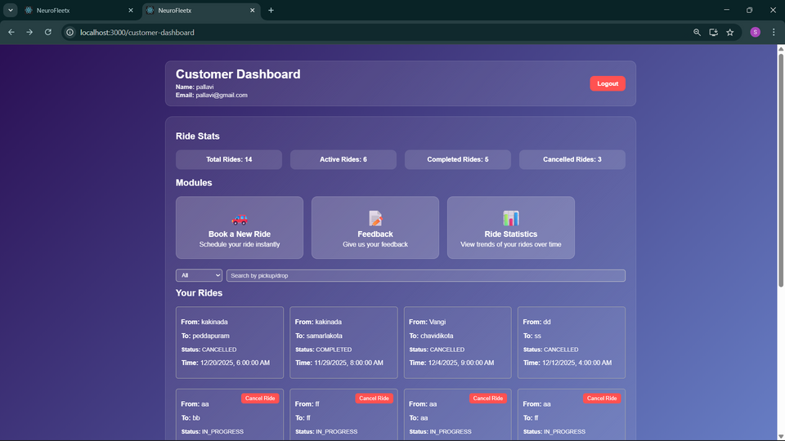
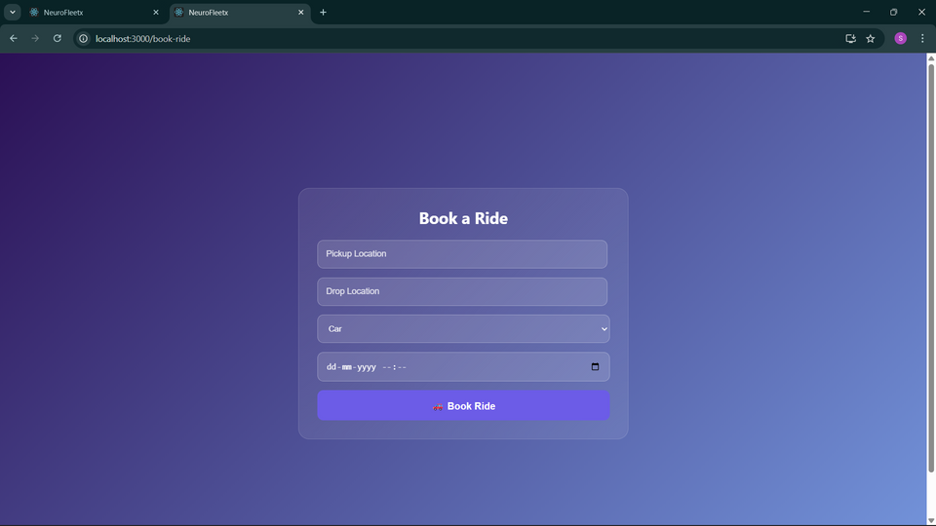
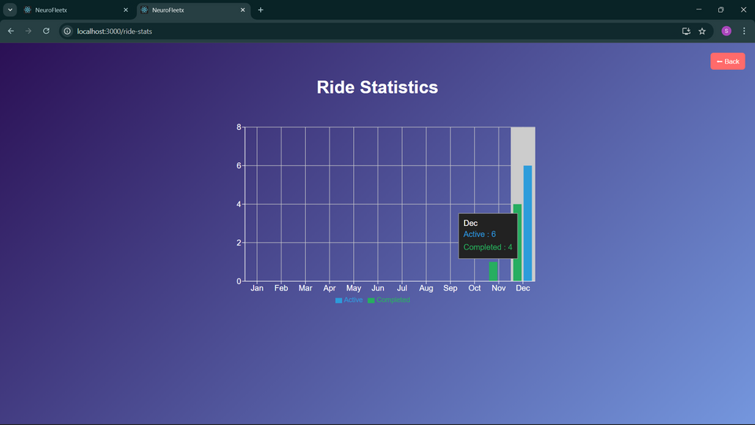
Module 2
Ride Booking & Tracking – Allows customers to book rides, view assigned drivers, track ride progress in real time, and access ride statistics such as completed rides, cancellations, and travel history.

Slide 7
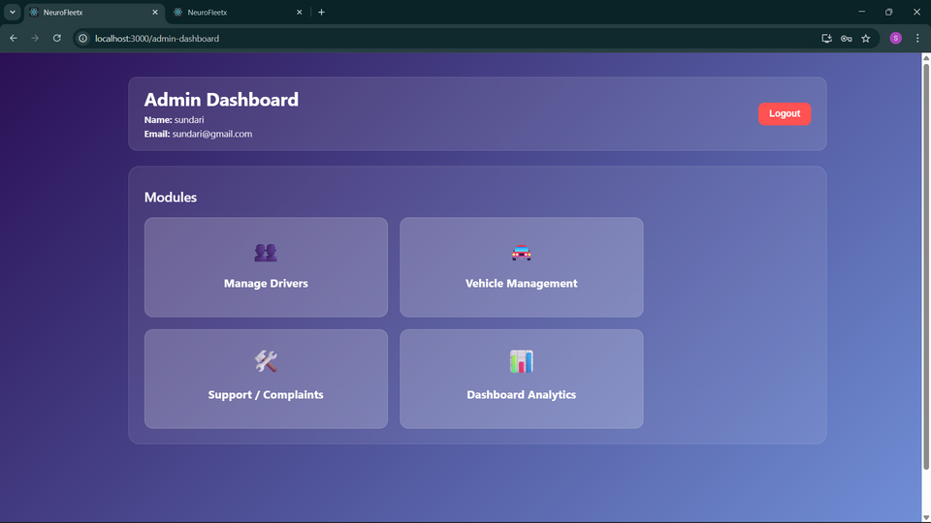
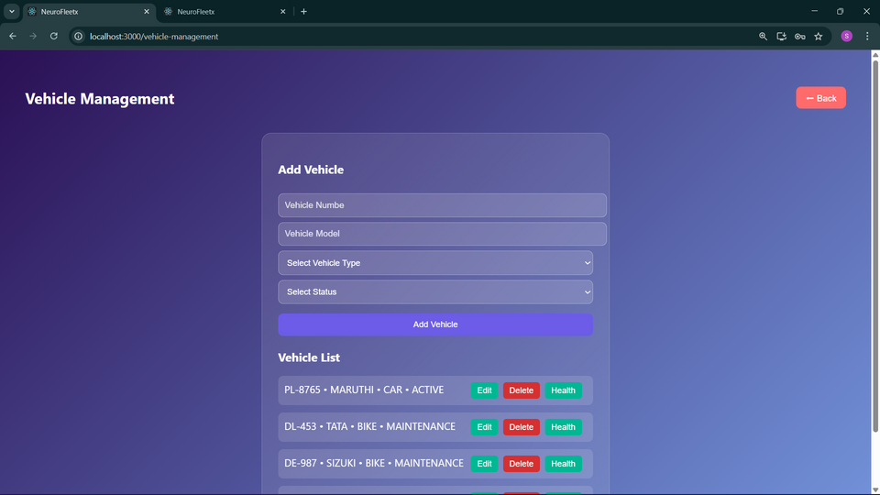
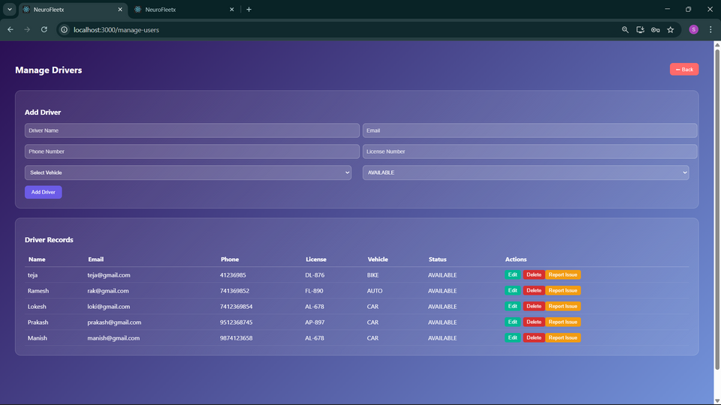
Module 3
Vehicle Management – Enables admins to add, update, and monitor vehicle details and their operational status, along with managing driver assignments and driver activity records.

Slide 8
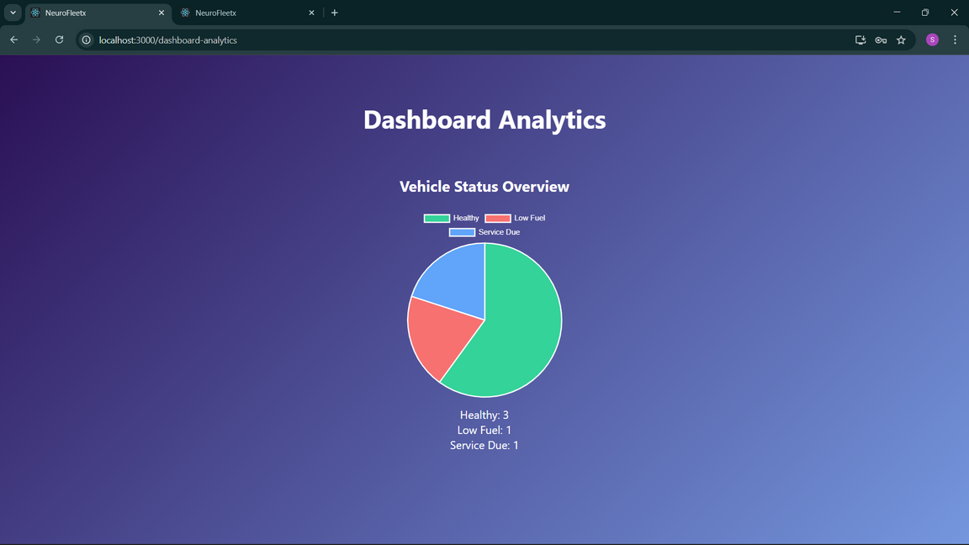
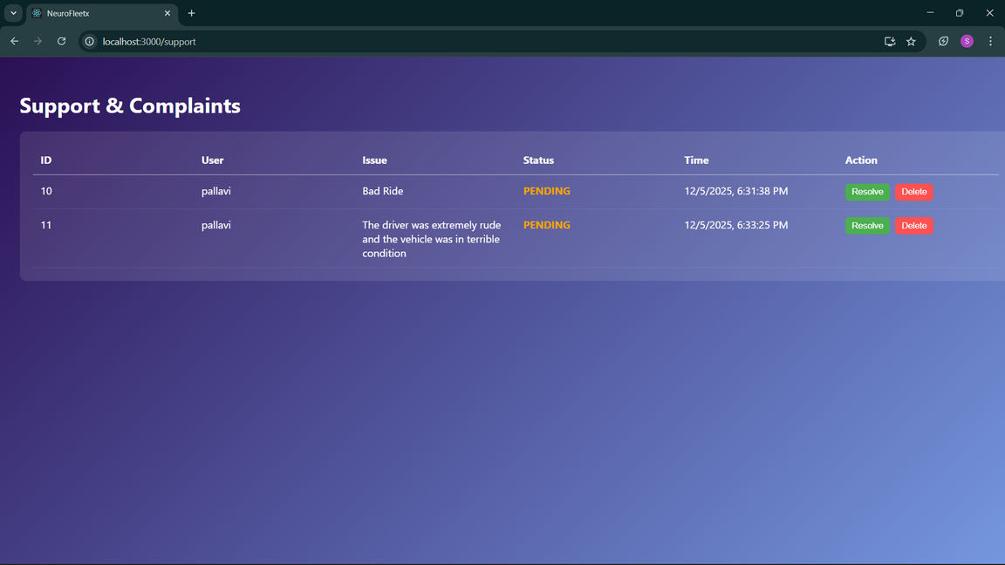
Module 4
Dashboard Analytics & Complaints Dashboard – Provides admins with real-time ride, user, and vehicle insights while enabling efficient tracking, filtering, and resolution of customer complaints.

Slide 9
Conclusion
  The project delivers a functional ride-management system with key features like ride booking, tracking, vehicle/driver management, complaints, and analytics.
  It improves user experience and operational efficiency by providing clear dashboards and real-time visibility.
  Minor limitations exist such as UI refinement and enhanced map accuracy.
  Future improvements can include live map integration, notifications, and advanced reporting.
  Overall, the project meets its objectives and provides a strong base for further development.

